Slide 1


Paper Title: UrbanKart A Spring Boot-Based Scalable E commerce Paper ID:101 Authors Name: Arindol Ghosh , Suraj Goswami , Debashis Kar , Binoy Gorai
1st NATIONAL CONFERENCE ON COMMUNICATION, COMPUTING & IOT
| February 28th – 1st March, 2025 |
Organized by : Department of IT & CSE (IoT, CS, BCT) Asansol Engineering College, in association with The Institution of Engineers (INDIA)
Presenter’s Name: Arindol Ghosh
Presenter’s Affiliation: INFORMATION TECHNOLOGY

Slide 2
Contents
1. Abstract
2. Introduction
3. Architecture
4.Contribution
5. Special Features
6.Study On Existing System
7. DFD
8. ERD
9. Conclusion
10. References
NCCCI 2025
Feb 28th – 1st Mar, 2025

Slide 3
1.Abstract
Built using Spring Boot, Thymeleaf , Spring Data JPA, and MySQL, UrbanKart is a sophisticated e-commerce platform that provides a safe, scalable, and intuitive purchasing experience. Through the integration of technologies that handle issues like scalability, personalization, and omnichannel integration, it responds to the growing demand for responsive digital platforms. Secure transactions, smooth user interactions, effective cart management, and a powerful admin dashboard for user and inventory management are some of the main features. UrbanKart also has a cutting-edge chatbot that helps consumers choose courses and make decisions by providing real-time, tailored support. In addition to satisfying e-commerce needs, this multifunctional platform helps engineering students by expediting the course selection process. In order to promote an inventive, sustainable ecosystem, future plans call for AI-driven recommendations, better cross-platform compatibility, and increased customisation. Built using Spring Boot, Thymeleaf, Spring Data JPA, and MySQL, UrbanKart is a cutting-edge e-commerce platform that provides effective administration and shopping options. It has features including an admin panel for easier inventory administration, secure payments, and optimized cart operations. Its interactive chatbot, which offers students individualized counsel while assisting them in exploring educational possibilities, is a noteworthy innovation. In order to create a multipurpose and innovative solution, future updates will focus on improving user experiences through AI-driven suggestions, enhanced device compatibility, and advanced customisation.
NCCCI 2025
Feb 28th – 1st Mar, 2025

Slide 4
2.Introduction
Urban Kart is a feature-rich e-commerce platform designed for a smooth and efficient shopping experience. It includes essential modules such as Home, Product, Category, Login, Register, and Forgot Password. Users can explore products through category-wise selection, use a powerful search bar for model-based searches, and view detailed product information. The platform allows seamless user registration, secure login, and password recovery. Customers can purchase products effortlessly and receive automated email notifications for order confirmations and updates.
An advanced admin dashboard provides comprehensive management features, including multiple admin roles, user control, and profile/password management. Admins can oversee product listings, categories, and user activities to ensure smooth platform operation. Both users and admins have the ability to update their profiles and passwords, enhancing security and personalization. Urban Kart prioritizes a secure, user-friendly interface with efficient navigation, making it an ideal platform for online shopping and business management.
The platform prioritizes security, efficiency, and user-friendliness, making it ideal for both customers and business owners. With a modern, intuitive interface, Urban Kart ensures a hassle-free shopping experience while providing admins with the tools necessary to manage operations effectively. Whether browsing for products or managing an online business, Urban Kart delivers a robust solution tailored for a dynamic digital marketplace.
NCCCI 2025
Feb 28th – 1st Mar, 2025

Slide 5
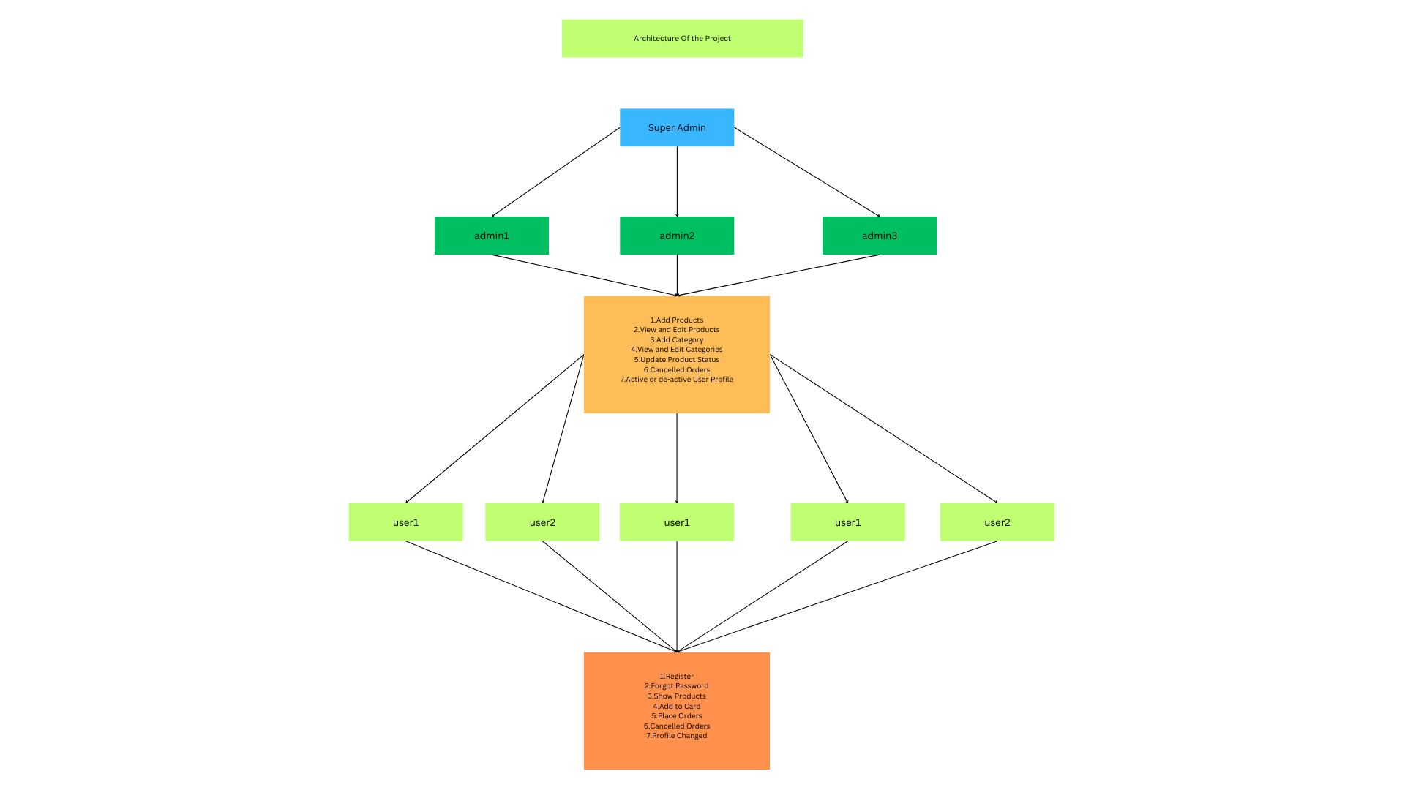
NCCCI 2025
Feb 28th – 1st Mar, 2025

Slide 6
Contribution
1. Suraj & Debashis (Front-End Development)
Roles: Front-End Design and Implementation
Technologies Used: HTML, CSS, Spring Web, Thymeleaf
2. Arindol (Back-End Development)
Roles: Back-End Development and Integration
Technologies Used: Spring Boot, MySQL, Spring Security, Spring Data JPA, Spring Boot DevTools , Lombok.
3. Binoy (JavaScript and Front-End Validation)
Roles: Validation and Front End-Database Interaction
Technologies Used: JavaScript, MySQL
Each team member has contributed uniquely to UrbanKart, with Suraj and Debashis taking care of the front-end design, Arindol handling the back-end functionality and integration, and Binoy ensuring all forms are validated seamlessly. This combined effort results in a high-quality, secure, and user-friendly eCommerce platform.
NCCCI 2025
Feb 28th – 1st Mar, 2025

Slide 7
Special Features
ERP-Based Model: Ensures seamless integration of inventory, sales, user management, and financial tracking for efficient business operations.
Multiple Admins with Super Admin Control: Supports multiple admin roles with a super admin who cannot be edited or deleted, ensuring secure hierarchical access.
Quick View of Added Features & Images: Allows real-time preview of product details and images for an enhanced user experience.
Advanced Security Protocols: Implements data encryption, SSL, and advanced firewall protection for superior security.
Pagination with Total Product Count: Features dynamic pagination with product count display for optimized browsing of large inventories.
Unified User & Admin Data Table with Microservice Security: Utilizes a microservice-based security layer for faster data retrieval and reduced system complexity.
Business Partnership with Admin Role: Enables users to apply for business collaboration under an agreement, with temporary admin privileges. Suspicious users can be instantly deactivated by the super admin.
NCCCI 2025
Feb 28th – 1st Mar, 2025

Slide 8
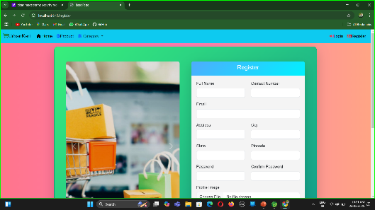
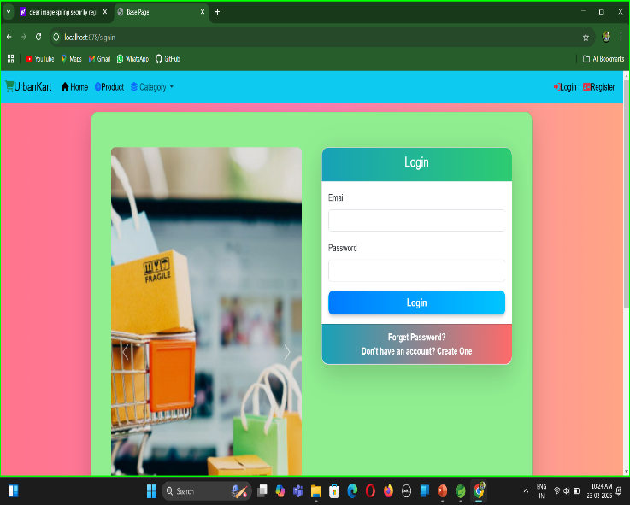
Study on existing System
Register
AppConst
1. Login , Register using Spring Security
Controller
SecurityConfig
CustomUser
Post
Request
User and Admins
Login
Get
Database
NCCCI 2025
Feb 28th – 1st Mar, 2025

Slide 9
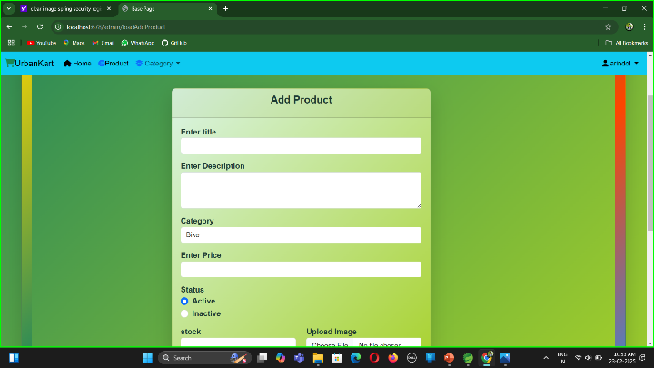
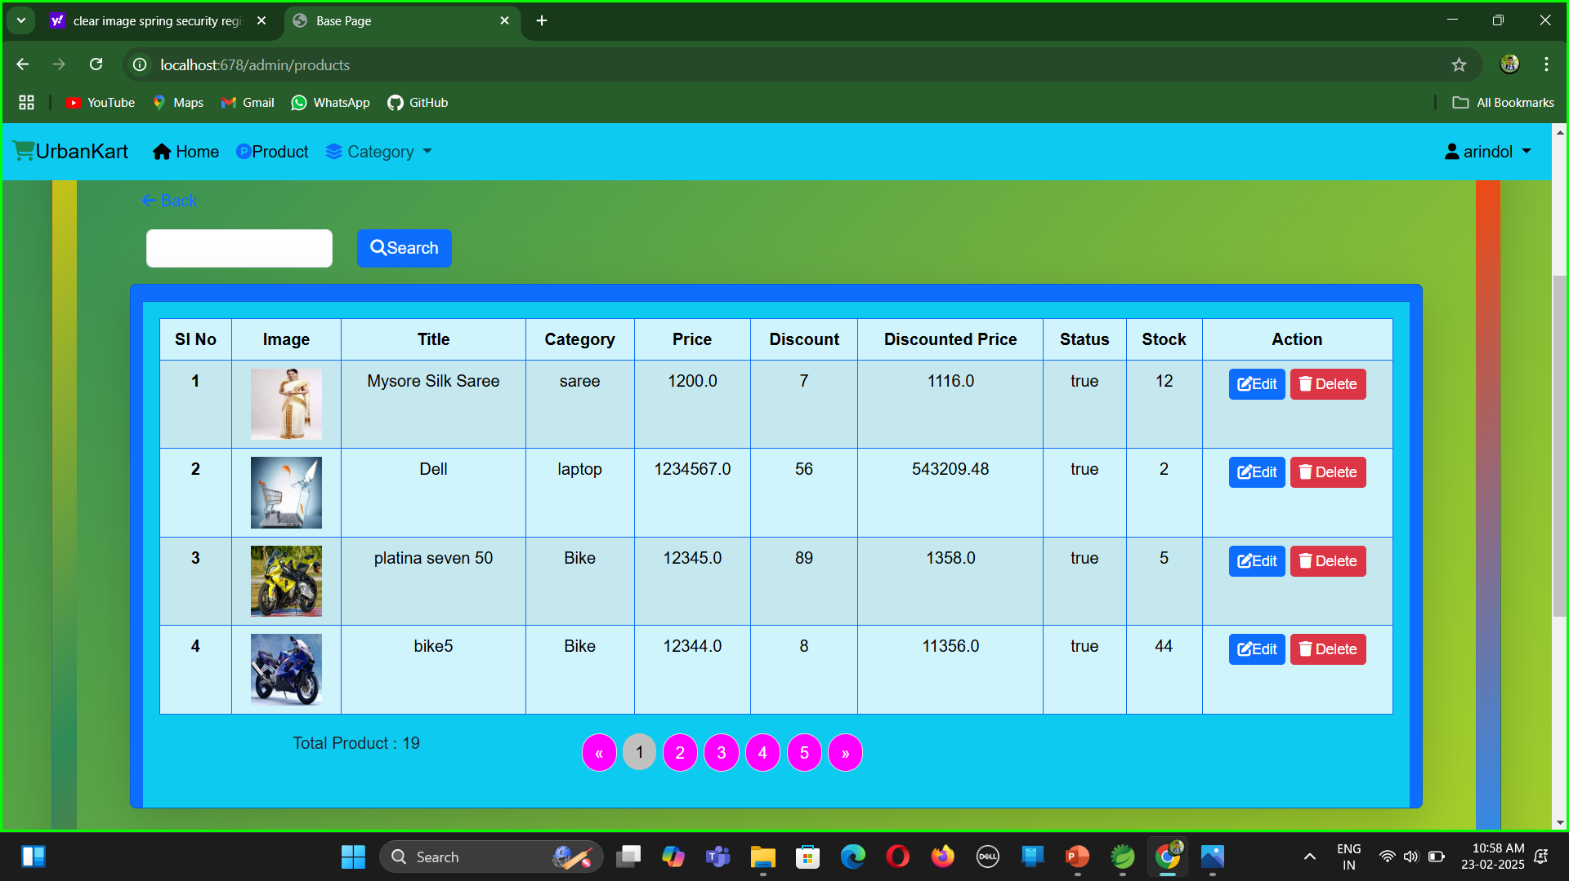
Study on existing System
2. Add , View , Edit , Delete Product By Admins
Add product
Request
Database
Add product Page
Get
Admins
Edit and Delete product
Updation Page
NCCCI 2025
Feb 28th – 1st Mar, 2025

Slide 10
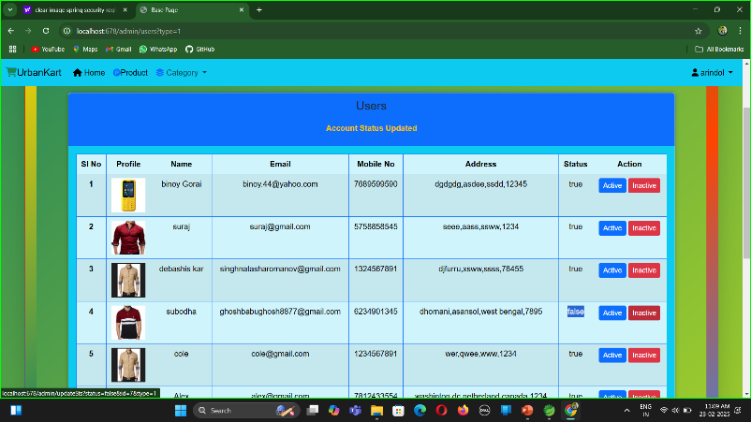
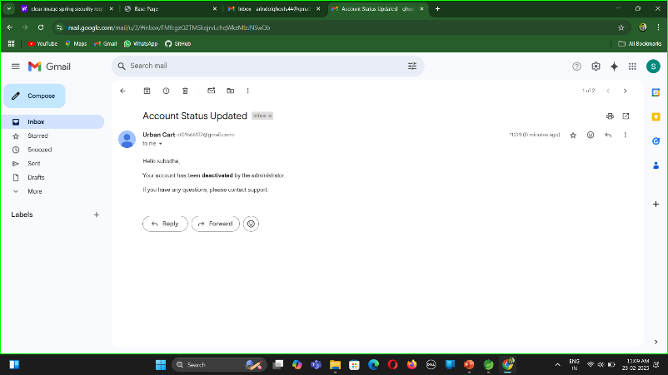
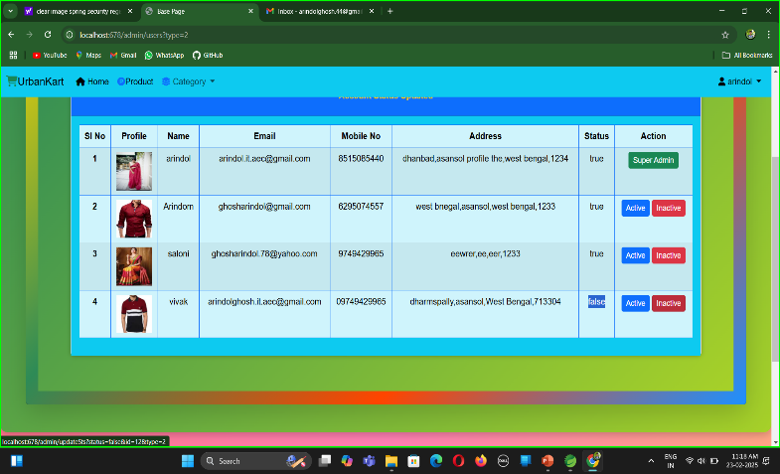
Study on existing System
3. Active and de-active the users as well as Admins by the super Admin and updated Notification Email Sended
User
Super admin
Users Page
Email
Admins
Admins Page
NCCCI 2025
Feb 28th – 1st Mar, 2025

Slide 11
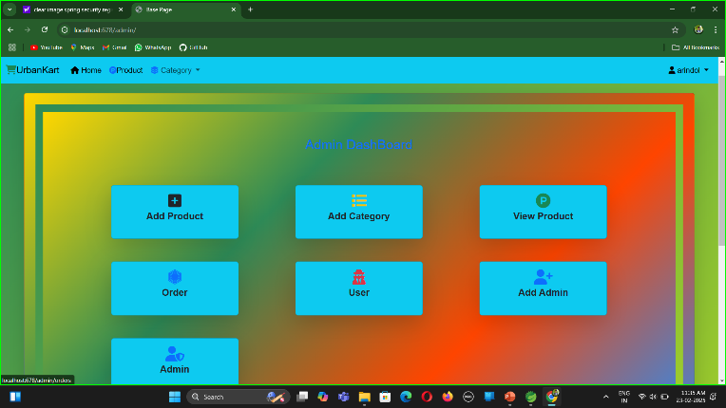
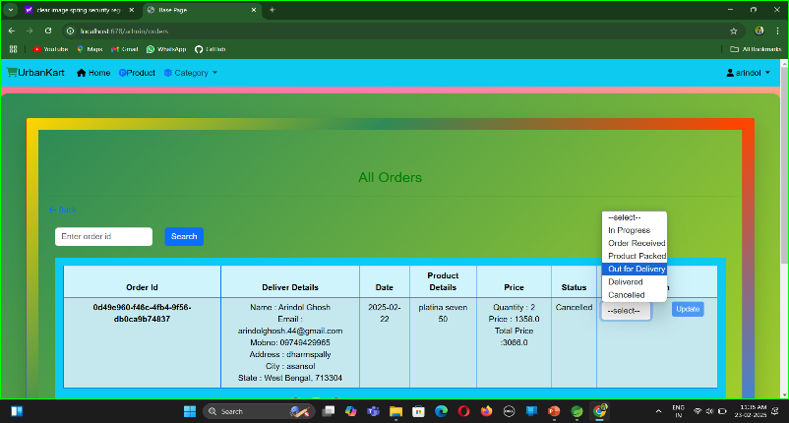
4. Update the status of orders of the users by the Admins and updated Notification Email Sended
Admins
Admin DashBoard
Orders Page
Email Notification
NCCCI 2025
Feb 28th – 1st Mar, 2025

Slide 12
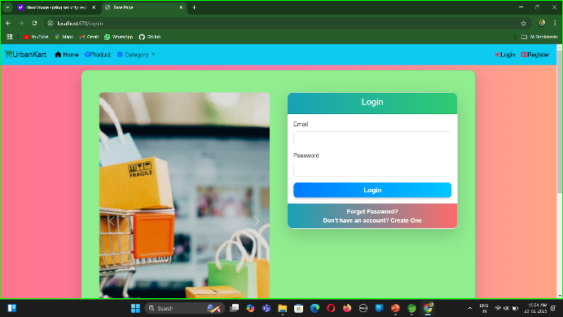
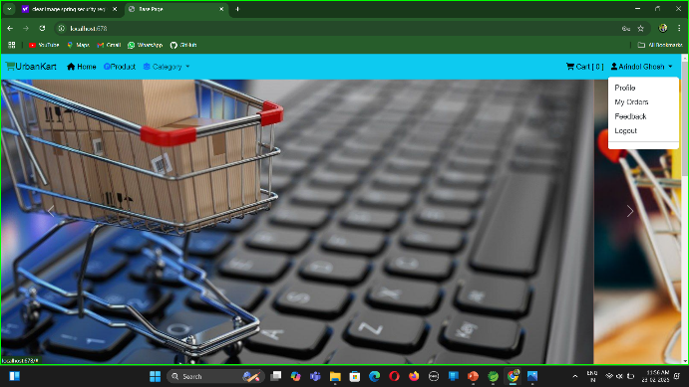
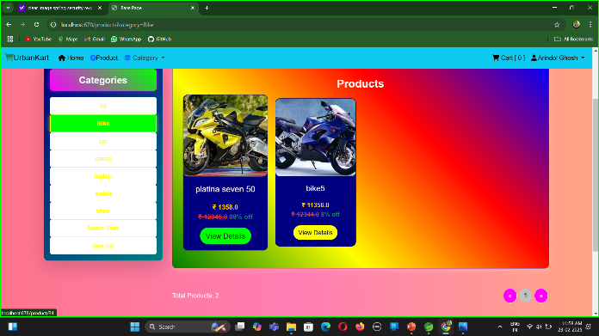
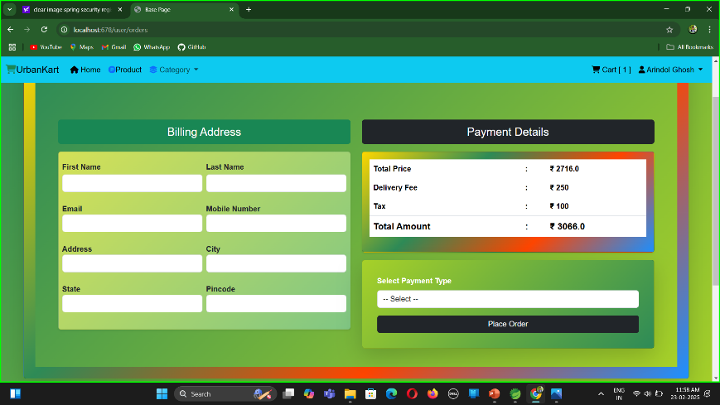
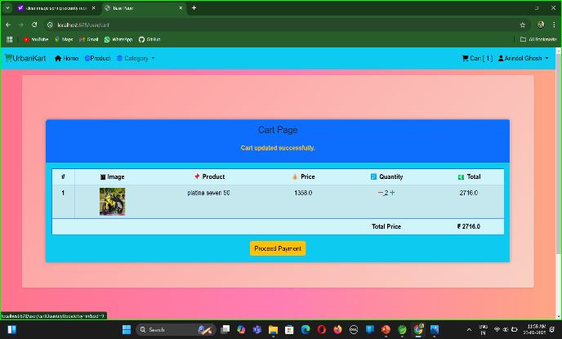
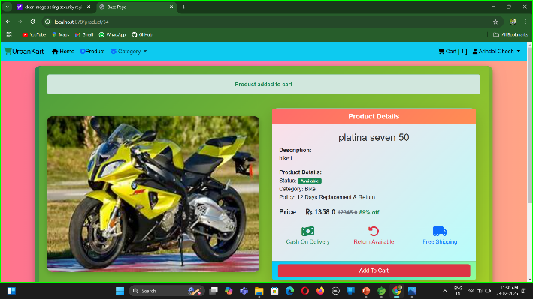
5. User Payment Gateway
User
Login
User Page
Products Page
View Product Page
Orders Page
Payment Page
NCCCI 2025
Feb 28th – 1st Mar, 2025

Slide 13
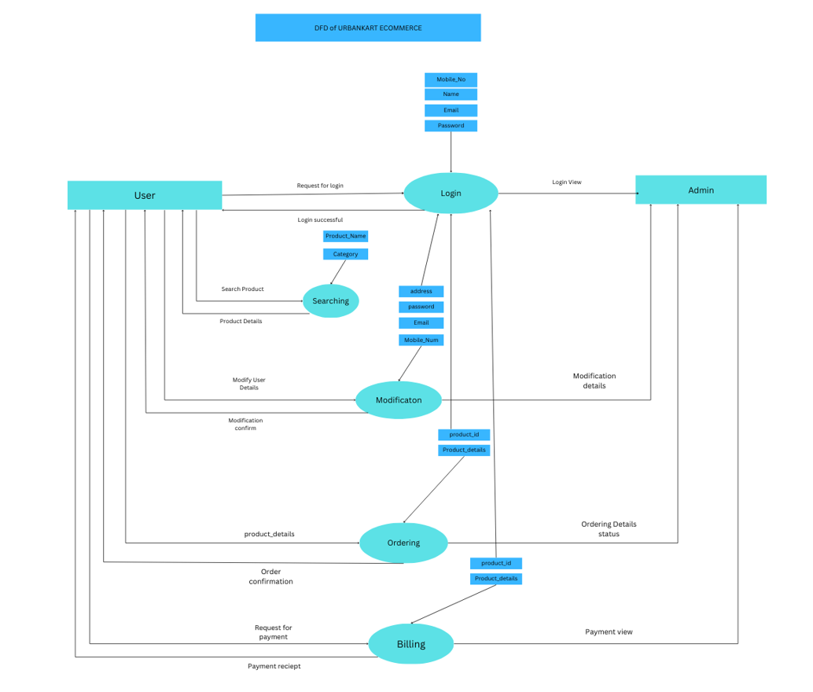
NCCCI 2025
Feb 28th – 1st Mar, 2025

Slide 14
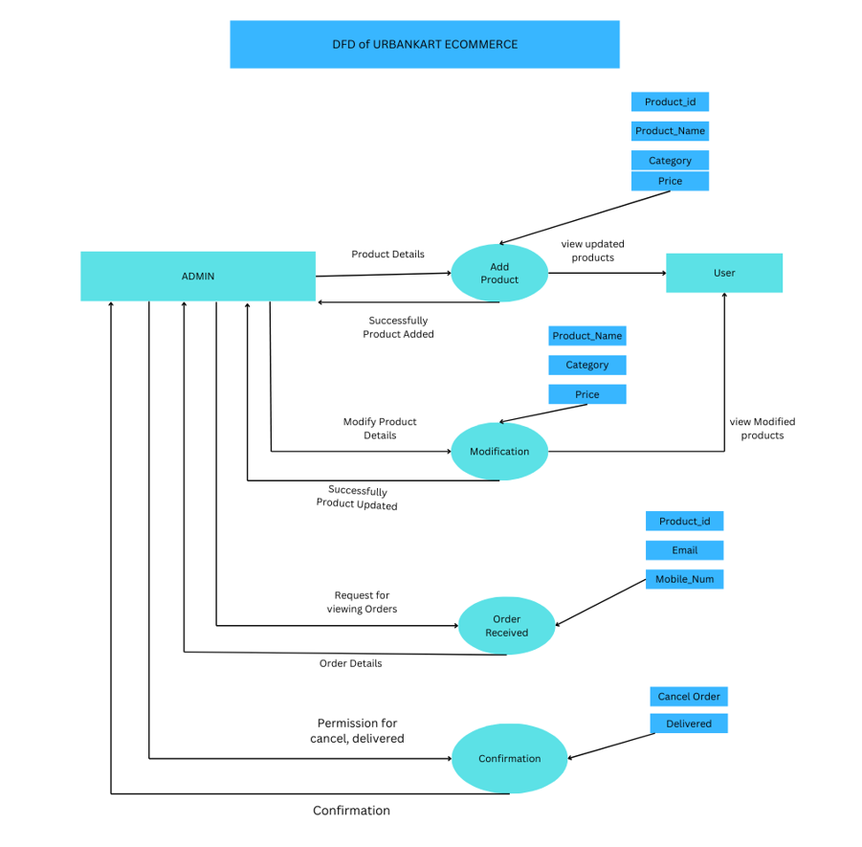
NCCCI 2025
Feb 28th – 1st Mar, 2025

Slide 15
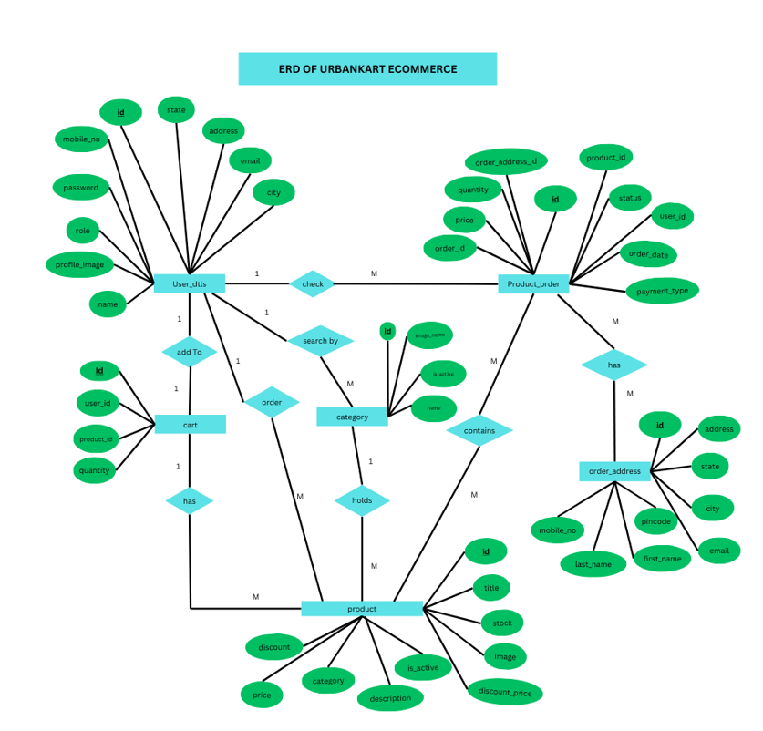
NCCCI 2025
Feb 28th – 1st Mar, 2025

Slide 16
Conclusion
The UrbanKart e-commerce project successfully utilized Spring Boot, HTML, CSS, and JavaScript to develop a user-friendly and efficient online shopping platform. By leveraging the strengths of Spring Boot for backend development and HTML, CSS, and JavaScript for frontend design, the platform offers a seamless user experience, robust functionality, and scalability. Key features such as secure authentication, shopping cart management, dynamic order processing, and real-time payment integration were implemented effectively. The project underscores the value of combining modern web technologies with a well-structured backend to meet user demands and business requirements.
Recommendations
Enhance User Experience:
Introduce AI-based product recommendations tailored to user preferences and behavior.
Implement dynamic filtering and sorting options for a more personalized shopping experience.
Improve Performance:
Use caching mechanisms such as Redis to optimize page load times.
Adopt database indexing to improve query execution speed.
Expand Features:
Add real-time notifications for order status updates and promotional offers.
Integrate a robust review and rating system to build user trust.
Strengthen Security:
Employ advanced authentication methods like OAuth2 and two-factor authentication (2FA).
Conduct regular security audits to identify and mitigate vulnerabilities.
Future Scalability:
Transition to a microservices architecture for better scalability and maintenance.
Leverage cloud services like AWS or Azure to handle increased traffic and storage needs.
NCCCI 2025
Feb 28th – 1st Mar, 2025

Slide 17
References
Spring Boot in Action by Craig Walls, ISBN: 978-1617292545
Spring Boot: Up and Running by Mark Heckler, ISBN: 978-1492076988
Spring Microservices in Action by John Carnell, ISBN: 978-1617293986
https://start.spring.io/
Spring Boot Cookbook by Alex Antonov, ISBN: 9781785289118
https://www.geeksforgeeks.org/what-is-dfddata-flow-diagram/?ref=gcse_ind
https://www.javatpoint.com/spring-boot-tutorial
NCCCI 2025
Feb 28th – 1st Mar, 2025

Slide 18
THANK YOU…
NCCCI 2025
Feb 28th – 1st Mar, 2025

